Slide 1
Tableau Assignment
A
Project Report On
“Financial Complaints”
Submitted By
Abhay Chauhan

Slide 2
CONTENTS
S.NO | CHAPTER NAME | PAGE NO.
01. | INTRODUCTION | 3
02. | SOURCE OF THE DATA | 4
03. | OUTCOME OF THE ANALYSIS | 5-13
04. | CONCLUSION | 14

Slide 3
INTRODUCTION
The main objective of the project is to design a dynamic, responsive dashboard with fully fledge logic and environment using various charts to make them visually beautiful , with various set of filters and color dimension.

Slide 4
SOURCE OF DATA
The data I have used in this project is from Kaggle.
The data name is “Financial Complaints” which has 670599 rows and 18 rows.
The column consist in the data are:
Date Received. 11. Tags.
Product. 12. Consumer Consent Provided?
Sub-Product. 13. Submitted Via.
Issue. 14. Date Sent to Company.
Sub-Issue. 15. Company Response to Consumer.
Consumer Complaint Narrative. 16. Timely Response.
Company Public Response. 17. Consumer Disputed.
Company. 18. Complaint ID.
State.
Zip Code.

Slide 5
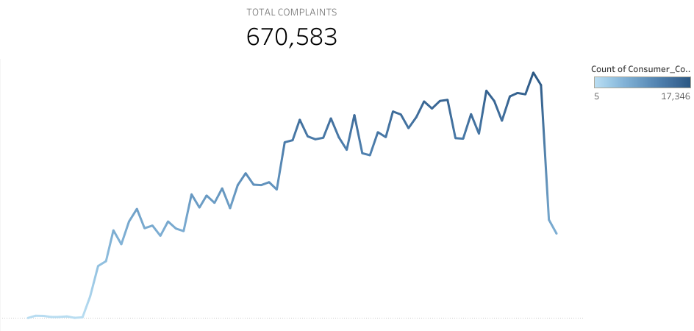
OUTCOME OF THE ANALYSIS
The First KPI in the dashboard represent the Total Complaints. In this KPI I have used the Consumer_Complaints present in the Measure Name and the Date Sent to Company Column. The Graph over here represent The Total Number of Complaints and Count of Complaints with each passing months.

Slide 6
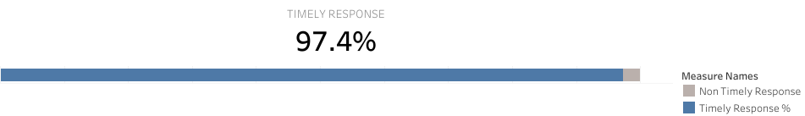
The Second KPI in the dashboard represent the Timely Response. In this KPI I have used two calculated function represented as % timely response and % non-timely response. In overall timely response comes out to be 97.4%.

Slide 7

The Third KPI in the dashboard represent the IN PROGRESS.
In this KPI I have used two calculated function representing the Count of IN PROGRESS complaints which turned out to be 4,665.
The second aggregate function used represent the percentage of IN PROGRESS complaints from the total complaints which turned out to be 0.70%.

Slide 8
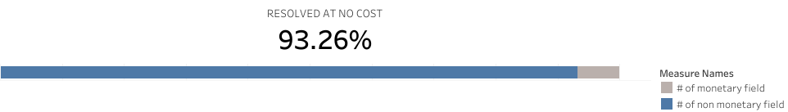
The Fourth KPI in the dashboard represent the RESOLVED AT NO COST. In which the all the non-monetary rows are taken in the account. In this KPI I have used two calculated function:
The first calculated function representing the % of non-monetary relief.
The second calculated function represent the % of monetary relief.

Slide 9
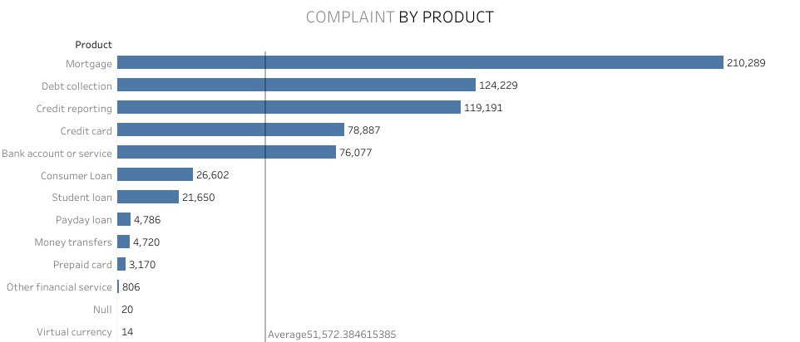
The Fifth KPI represent the COMPLAINT BY PRODUCT. In this KPI I have used the Product and the Consumer_Complaint Column and the chart will represent the different product and the total number of complaints presented with in those product. Also, average line has been presented in this chart.

Slide 10
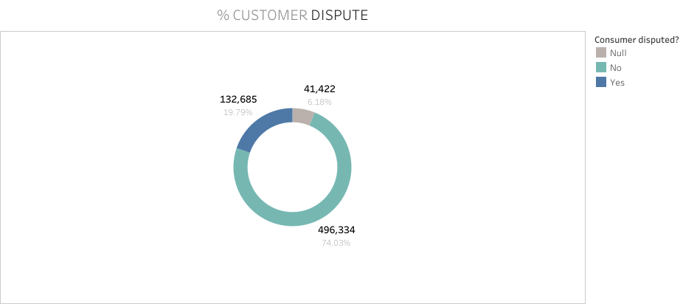
The Sixth KPI represent the CUSTOMER DISPUTE. In which the chart represent the share of ratio of “YES”,”NO” and “NULL”.
In this KPI I have used the Customer Dispute Column which is represented by YES, NO and NULL.
In Order to present the Customer Dispute, I have represented it in a Pie Chart.
Duplicate Chart are created then with the help of Dual Axis a Donut Chart is created.

Slide 11
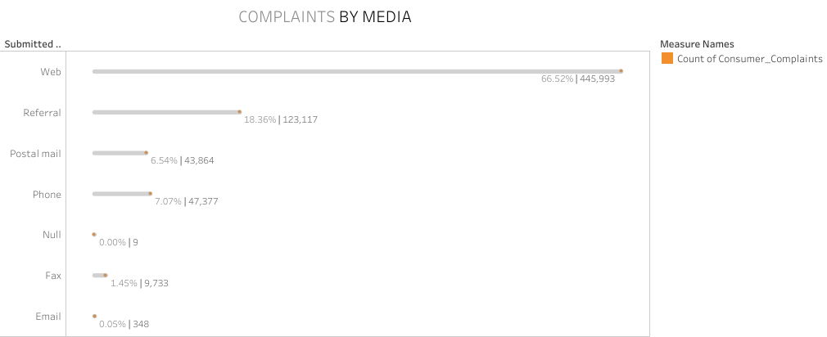
The Seventh KPI represent the COMPLAINTS BY MEDIA. This KPI present the count of number of complaints in the different source of media.
In this KPI I have used the Submitted Via Column and the other column presented as the dummy column using the total complaints.

Slide 12
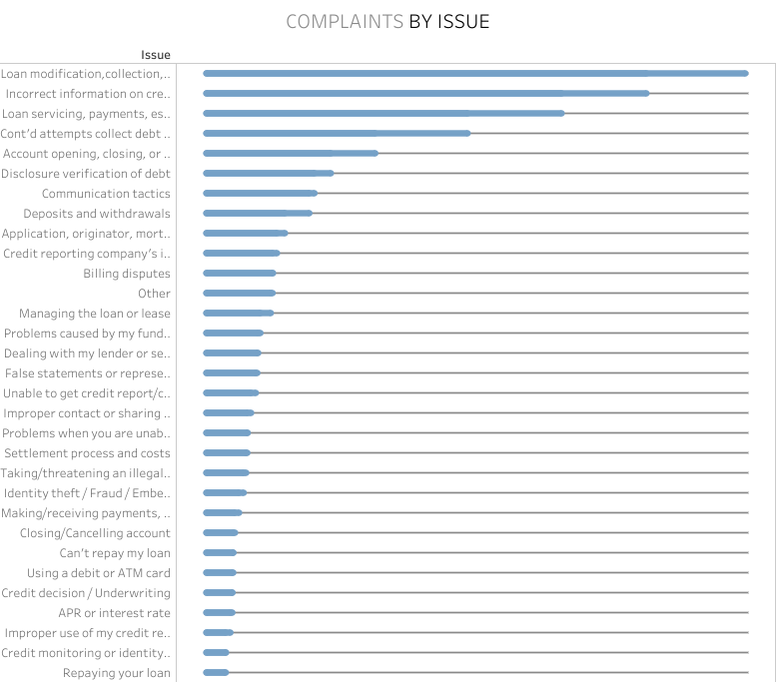
The Eight KPI represent the COMPLAINTS BY ISSUE. The KPI present the count of number of complaints presented in the different issues.
In this KPI I have used the Issue column plus a calculated field representing the Max complaints of the Issue column.

Slide 13
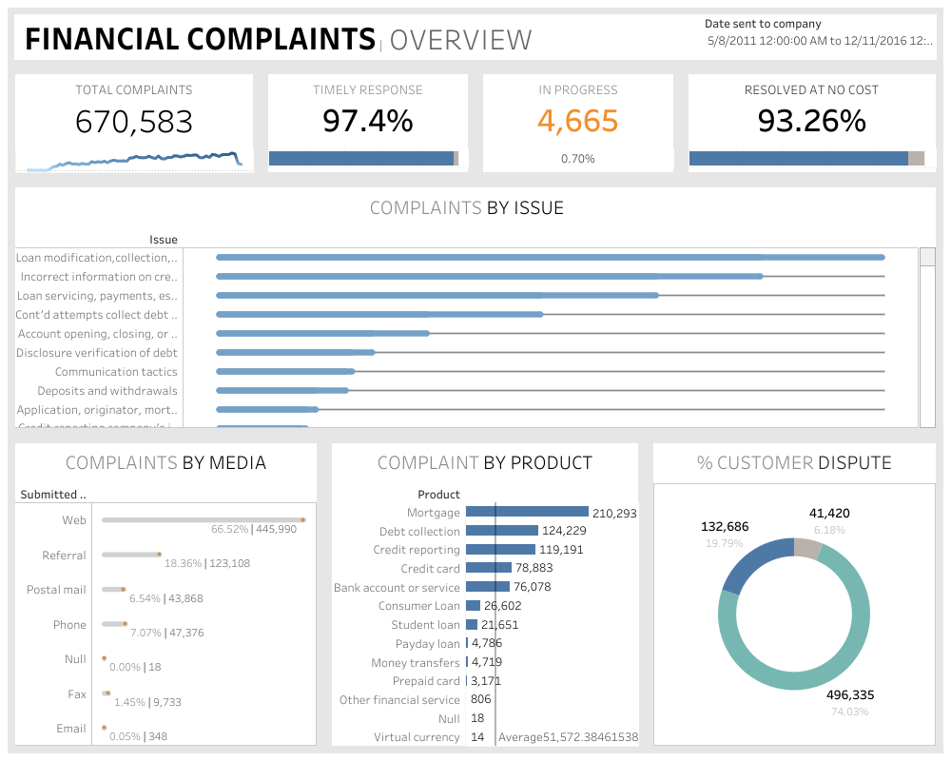

Slide 14
CONCULSION
Here, I have come to the end of my detailed analysis of my project.
I tried my best to include all the necessary points that are related to the given assignment on Tableau. This project contains information on the various charts analysis where each of the five explains the total sales in the specific region. Also, a proper dashboard has been maintained containing all the charts represented in the proper format. With, Filters and Title Provided in it.
I do hope that my project will be insightful and look visually impairing.
I have prepared the dashboard on Tableau Online. I will be sharing the credentials where you can access my dashboard.
Email Id – Jyoti.Chauhan@avvashyacci.com
Password – Abhay#5025

